Slide 1

NHS western isles
Hospital at Home

Slide 2

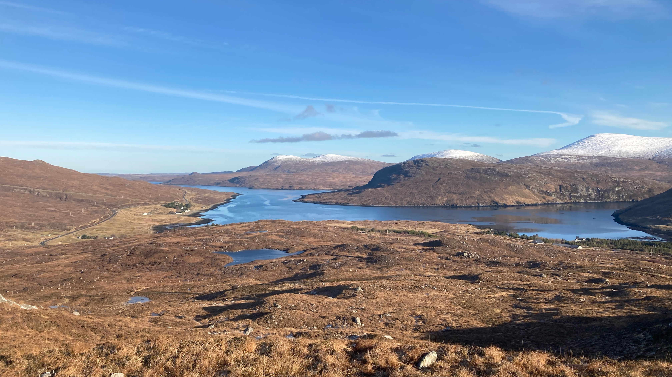
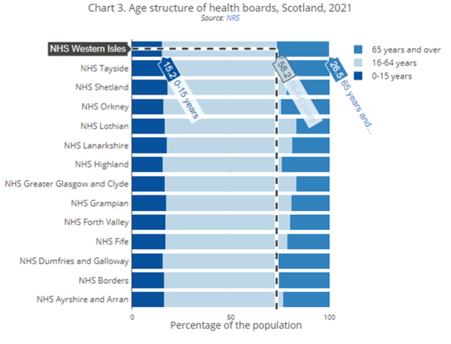
Challenges of remote and rural healthcare

Slide 3
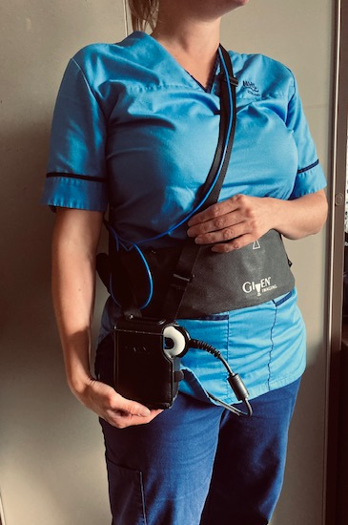
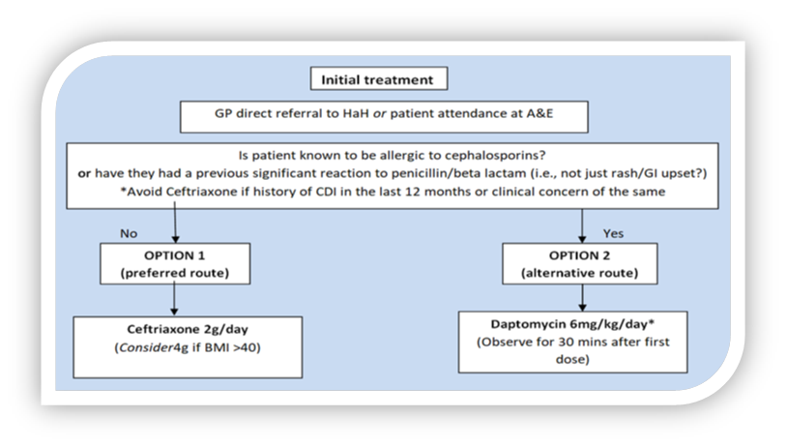

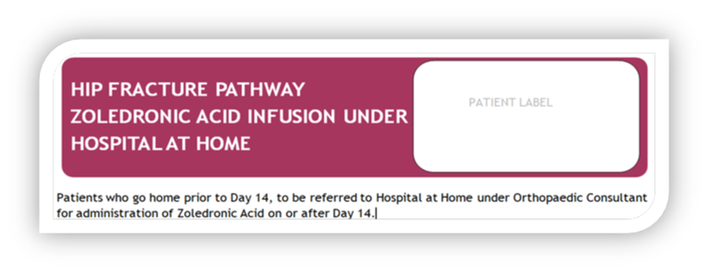
Unique island model
NHSWI specific service
Acute hospital patients;
Observations
Blood monitoring
IV antibiotics
IV/SC diuretics
IV/SC fluids
Oxygen therapy

Slide 4
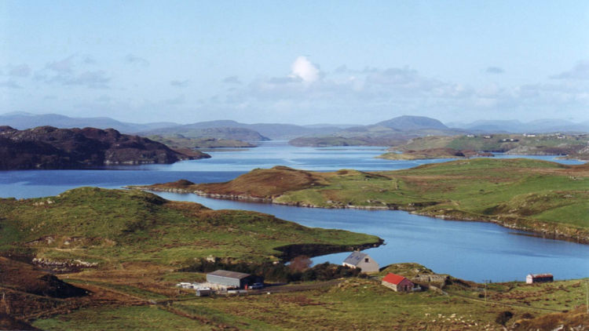

service delivery challenges
Geography
Clinical Workforce
Carer support
Unfamiliar environment
Demand
Do I need to leave my home?
Do I WANT to leave my home?
Familiarity
Patient centered

Slide 5

What can we do to improve the rural journey
Collaborative working
Novel clinical roles
Short term care support/family involvement during the acute episode
Realistic medicine
Future Care Planning

Slide 6

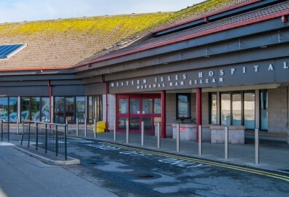
front door

Slide 7


Care home project
Care home staff
GP
Family
Urgent Care
Community Nurses
Hospital at Home
Macmillan
Dementia services
Patient

Slide 8



Next steps

Slide 9




Thank you

